Slide 1




Functions and Function Expressions
Closures, Function Scope, Nested Functions, IIFE
Advanced
JavaScript
SoftUni Team
Technical Trainers
Advanced JS
Software University
http://softuni.bg

Slide 2

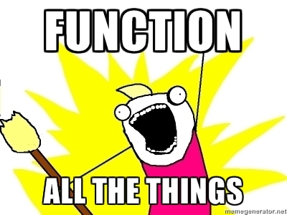
Table of Contents
Functions in JavaScript
Function Object
Defining Functions
Function Declarations
Function Expressions
Function Constructor
Expression vs. Declaration
Function Properties
Function Methods

Slide 3
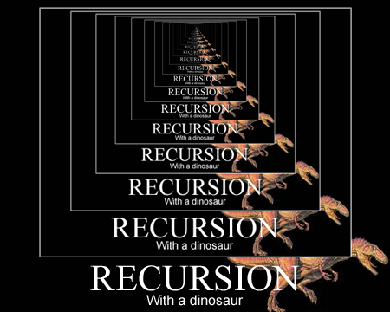
Table of Contents (2)
Recursion
Factorial Example
Traversing the DOM
Recursion with Expressions
Scope
Global and Function
Nested Functions
Immediately-Invoked Function Expressions (IIFE)
Closures

Slide 4


Functions in JavaScript

Slide 5
Functions in JavaScript
A function is a small named snippet of code
Can be invoked using their identifier (name)
Functions can take parameters of any type
Function can return a result of any type
undefined is returned if there is no return statement
Each function is given two special objects:
this contains information about the context
The context is depending on the way the function is invoked!
arguments contains all passed arguments

Slide 6
Functions in JavaScript (2)
Different function usages:
function max(arr) {
var maxValue = arr[0];
for (var i = 1; i < arr.length; i++) {
maxValue = Math.max(maxValue, arr[i]);
}
return maxValue;
}
function printMsg(msg) {
console.log(msg);
}

Slide 7

Functions in JavaScript
Live Demo

Slide 8

Functions as Objects

Slide 9
Functions as Objects
In JavaScript functions are first-class objects
One of the most powerful features in JavaScript
You can set properties on them
You can invoke methods on them
They have properties of their own
length, caller, name, apply, call
function max(arr) { … }
console.log(max.length); // prints 1
console.log(max.name); // prints "max"
console.log((function(){}).name); // prints "" (empty string)

Slide 10
Functions as Objects (2)
Functions are objects and they can be used as objects
Can be passed as arguments to other functions
Can be stored in an array
Can be assigned to variables
Can be returned by another function
var arr = [3, 2, 1, 3, 4, 5, 1, 2, 3, 4, 5, 7, 9];
function orderBy(x, y) { return x - y; }
arr.sort(orderBy);
// Better to be done using anonymous function
arr.sort(function(x, y) { return x - y; });

Slide 11

Function Object
Live Demo

Slide 12

Defining Functions

Slide 13
Creating Functions
Functions can be defined in several ways:
Function declaration
Function expression
Function constructor
Since functions are quite special in JavaScript, they are loaded as soon as possible
function printMsg (msg) { console.log(msg); }
var printMsg = function (msg) { console.log(msg); }
var printMsg = new Function('msg', 'console.log("msg");');

Slide 14
Function Declaration
Function declarations use the function operator to create a function object
Function declarations are loaded first in their scope
No matter where they appear
This allows using a function before it is defined!
printMsg("Hello");
function printMsg(msg) {
console.log("Message: " + msg);
}

Slide 15

Function Declarations
Live Demo

Slide 16
Function Expression
Function expressions are created using the function literal
They are loaded where they are defined
Cannot be used beforehand
Can be invoked immediately
The name is optional (can be anonymous)
var printMsg = function (msg) {
console.log("Message: " + msg);
}
printMsg("Hello");

Slide 17
Function Expression (2)
Function expressions do no need an identifier (it is optional)
It is better to define it for easier debugging
Otherwise the debuggers show anonymous
Types of function expressions
var printMsg = function (msg) {
console.log("Message: " + msg);
}
var printMsg = function printMsg(msg) {
console.log("Message: " + msg);
}
(function(){ … });

Slide 18
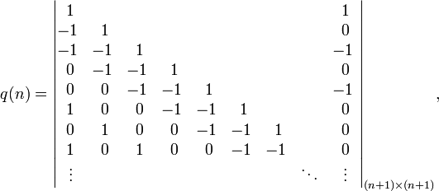
Function Expressions
Live Demo

Slide 19
Function Constructor
Function constructor is similar to expressions
A constructor initializes a function object
It is loaded when the parser reaches it
The function constructor form is:
Example:
Bad practice: Low performance and messy code
new Function([optional argument1, argument 2, …], body);
var printMsg = new Function("msg", "console.log(msg);");
printMsg("Hello!");

Slide 20




Function Constructor
Function
Constructor
Live Demo

Slide 21
Function Expression vs. Function Declaration
Function declarations are loaded first
Can be used before they are declared
Can be overridden
Function expressions are loaded when reached
Can be used only after creation
Imagine two function declarations in the same scope have the same name
Which will be the one to execute?

Slide 22
Function Expression vs. Function Declaration (2)
Function declarations can be overridden
Results with unexpected behavior
logs "from if" only in Firefox
if (true) {
function printMsg(msg) {
console.log("Message (from if): " + msg);
}
}
else {
function printMsg(msg) {
console.log("Message (from else): " + msg);
}
}
printMsg("message");
logs "from else" in Opera, IE and Chrome

Slide 23
Function Expression vs. Function Declaration (3)
Easy to fix with function expressions
Works well on all browsers
if (true) {
var printMsg = function (msg) {
console.log("--from if: " + msg);
}
}
else {
var printMsg = function (msg) {
console.log("--from else: " + msg);
}
}
printMsg("message");
Logs ("from if") in all browsers

Slide 24

Function Declaration vs. Function Expression
Live Demo

Slide 25
Function Properties
Values
Object
Methods

Slide 26
Function Properties
Each function is an object
Created either with declaration, expression or constructor
Functions have properties:
function.length
The count of parameters the function expects
The arguments object is not counted
function.name
Identifier of the function
Returns an empty string if anonymous

Slide 27
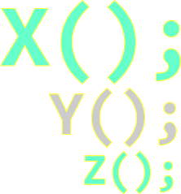
Function Methods

Slide 28
Function Methods
Functions have methods as well
function.toString()
Returns the source code of the function as a string
function.call(obj, arg1, arg2, …)
Calls the function over the obj with arg1, arg2, …
function.apply(obj, arrayOfArgs)
Applies the function over obj using the arrayOfArgs as arguments

Slide 29
Function Methods – apply() and call()
function.apply(obj, arrayOfArgs)
Invokes the function with obj used as this
Arguments passed as array of values
function.call(obj, arg1, arg2, …)
Invokes the function with obj used as this
Arguments separated by commas
Difference between call and apply
The way of passing the function arguments

Slide 30
Apply and Call – Examples
function.apply(obj, arrayOfArgs)
function.call(obj, arg1, arg2, …)
var numbers = [1, 54, 2, 324, 2];
var max = Math.max.apply(null, numbers);
function printMsg(msg) {
console.log("Message: " + msg);
}
printMsg.apply(null, ["Important message"]);
// Here "this" is null, since it is not used in the function

Slide 31
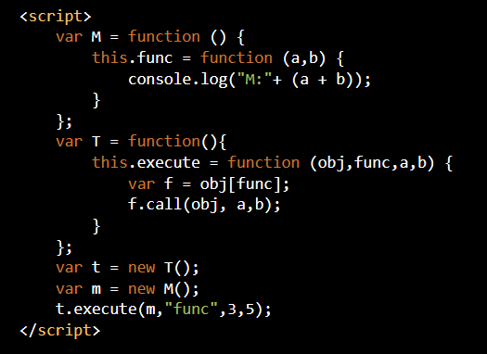
Function Methods
Live Demo

Slide 32
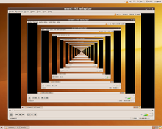
Recursion
Calling Functions from Themselves

Slide 33
Recursion
Recursion is when a function calls itself
A powerful programming technique
May be direct or indirect
Example:
function factorial(n) {
if (n == 0) {
return 1;
}
return factorial(n-1) * n;
}
Bottom of the recursion. A recursion must always have a bottom!

Slide 34
Recursion (2)
Recursion works quite well when:
Traversing non-linear data structures
Trees, matrices, graphs, DOM nodes
Generating combinations / variations / permutations / …
Generating sequences: Fibonacci, factorial, …
Every recursion can be replaced by enough loops
Also called iterative solution
Yet, in some cases using recursion is simpler than using loops

Slide 35
Recursion: Factorial
Using recursion to calculate factorial numbers
Using the formula F(N) = F(N-1) * N
function factorial(n) {
if (n == 0) {
return 1;
}
return factorial(n - 1) * n;
}
console.log(factorial(5)); // 120
console.log(factorial(12)); // 479001600

Slide 36
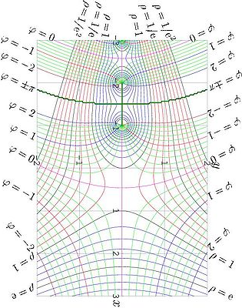
Factorial
n!
1*2*3*…n
Live Demo

Slide 37
Traversing the DOM Recursively
For each element print its tag name and invoke the same function recursively for each of its children
function traverse(node) {
traverseNode(node, '');
function traverseNode(node, spacing) {
spacing = spacing || ' ';
console.log(spacing + node.nodeName);
for (var i = 0, len = node.childNodes.length; i < len; i += 1) {
var child = node.childNodes[i];
if (child.nodeType === document.ELEMENT_NODE) {
traverseNode(child, spacing + ' ');
}
}
console.log(spacing + '/' + node.nodeName);
}
}

Slide 38
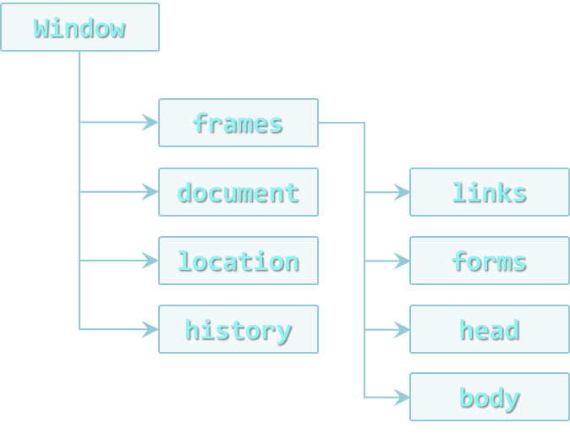
DOM Traversal
Live Demo

Slide 39


Recursion with Function Expression
Recursion is simple enough with function declarations
But not so easy with function expressions
Call function
Assign the function to a variable
Assign a number value to the original function
logs 120
var fact = function (n) {
if (n === 0) {
return 1;
}
return n * fact (n - 1);
};
fact(5);
var f = fact;
f(5);
logs 120
fact = 5;
f(5);
logs NaN

Slide 40

Buggy Recursion with Function Expressions
Live Demo

Slide 41
Recursion with Function Expression (2)
The previous example can be solved by giving an identifier to the function expression
Only the function itself can use this identifier
var factorial = function factorial(n) {
if (n == 1) {
return 1;
}
return n * factorial(n - 1);
//or use arguments.callee
};
var factorial2 = factorial;
factorial = 5;
console.log(factorial2(5)); // prints 120 → correct

Slide 42

Working Recursion with Function Expressions
Live Demo

Slide 43

Variable Scope

Slide 44
Variable Scope in JS
Scope is a place where variables are defined and can be accessed
JavaScript has only two types of scopes
Global scope is the same for the whole web page
Function scope is different for every function
Everything outside of a function scope is inside of the global scope
if (true) {
var sum = 1 + 2;
}
console.log(sum); // logs: 3
JavaScript doesn't have block scope like C# and Java

Slide 45
Global Scope
The global scope is the scope of the web page
Objects belong to the global scope if:
They are defined outside of a function scope
They are defined without var (fixable with 'use strict')
arr, separator and i belong to the scope of printArr(…)
function arrJoin(arr, separator) {
separator = separator || "";
arr = arr || [];
arrString = "";
for (var i = 0; i < arr.length; i += 1) {
arrString += arr[i];
if (i < arr.length - 1) arrString += separator;
}
return arrString;
}
arrString and arrJoin belong to the global scope

Slide 46

Global Scope – Don't Use It!
The global scope is one of the very worst parts of JavaScript
Every object pollutes the global scope, making itself more visible
Increases the potential coupling
If two objects with the same identifier appear
The first one will be overridden

Slide 47

Global Scope
Live Demo

Slide 48
Function Scope
JavaScript does not have a block scope like other programming languages (C#, Java, C++)
{ and } does not create a scope!
Yet, JavaScript has a function scope
Function expressions and function declarations create scope
if (true) { var result = 5; }
console.log(result); // logs 5
if(true) (function(){ var result = 5;})();
console.log(result); // ReferenceError
function logResult(){ var result = 5; }
if(true) logResult();
console.log(result); // ReferenceError

Slide 49
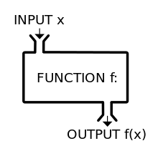
Function Scope
Live Demo

Slide 50
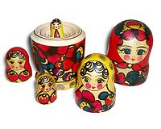
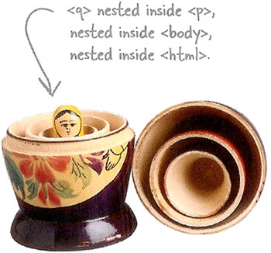
Nested Functions

Slide 51
Nested Functions
Functions in JavaScript can be nested
It's all about scope!
No limitation of the level of nesting
Objects can access the scope they are in (also called closure)
The inner scope can access everything above it
﻿function compare(str1, str2, caseSensitive) {
if (caseSensitive) { return compareCaseSensitive(str1,str2); }
else { return compareCaseInsesitive(str1, str2); }
function compareCaseSensitive(str1, str2) { … };
function compareCaseInsesitive(str1, str2) { … };
}

Slide 52
Nested Functions: Example
Objects can access the scope they are in
outer() can access the global scope
inner1() can access the scope of outer()
And through outer() – can access the global scope and etc…
var str = "I am happy"; //global scope
function outer(o1, o2) { //outer scope
function inner1(i1, i2, i3) { //inner1 scope
function innerMost(im1) { //innerMost scope
…
} //end of innermost scope
} //end of inner1 scope
function inner2(i1, i2, i3) { //inner2 scope
…
} //end of inner2 scope
} //end of outer scope
var number = 1; //global scope

Slide 53
Nested Functions and Scope
What about objects with the same name?
If in the same scope – the bottommost object
If not in the same scope – the object in the innermost scope
function compare(str1, str2, caseSensitive) {
if(caseSensitive) return compareCaseSensitive(str1, str2);
else return compareCaseInsesitive(str1, str2);
function compareCaseSensitive(str1, str2) {
// here the casing (upper / lower) of str1 and str2 matters
}
function compareCaseInsesitive(str1, str2) {
// here the casing of str1 and str2 does not matter
}
}

Slide 54

Nested Functions
Live Demo

Slide 55

Immediately Invoked Function Expressions (IIFE)
Functions Invoked Immediately after They are Created

Slide 56
Immediately Invoked Function Expressions
In JavaScript, functions expressions can be invoked immediately after they are defined
Can be anonymous
Create a function scope
Don't pollute the global scope
Handle objects with the same identifier
IIFE must be always an expression
Otherwise the browsers don't know what to do with the declaration

Slide 57
Valid IIFE
Valid IIFEs
IIFEs are primary used to create function scope
IIFE prevents naming collisions
In all cases the browser must be explicitly told that the thing before () is an expression
var iife = function(){ console.log("invoked!"); }();
(function(){ console.log("invoked!"); }());
(function(){ console.log("invoked!"); })();
!function(){ console.log("invoked!"); }();
true && function(){console.log("invoked!"); }();
1 + function(){console.log("invoked!"); }();

Slide 58
Immediately Invoked Function Expressions (IIFE)
Live Demo

Slide 59

Closures
Functions that Refer to Independent (Free) Variables

Slide 60
Closures
Closures are a special kind of structure
They combine a function and the context of this function
Function defined in the closure “remembers” the environment in which it was created
inner() forms a closure. It holds a reference to x
function outer(x) {
function inner(y) {
return x + " " + y;
}
return inner;
}
In the context of f1, x has value 5
var f1 = outer(5);
console.log(f1(7)); // outputs 5 7
In the context of f2, x has value "Peter"
var f2 = outer("Peter");
console.log(f2("Petrov")); // outputs Peter Petrov

Slide 61

Simple Closures
Live Demo

Slide 62
Closures Usage
Closures can be used for data hiding (encapsulation in OOP)
Make objects invisible to the outside (private)
var school = (function() {
var students = [];
var teachers = [];
function addStudent(name, grade) {...}
function addTeacher(name, speciality) {...}
function getTeachers(speciality) {...}
function getStudents(grade) {...}
return {
addStudent: addStudent,
addTeacher: addTeacher,
getTeachers: getTeachers,
getStudents: getStudents
};
})();
This is actually called a Module

Slide 63
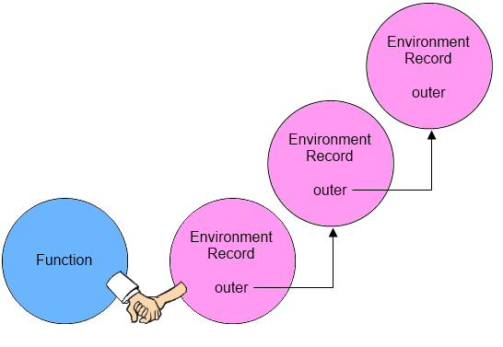
Closures
Live Demo

Slide 64


Summary
What information does this contain?
this contains information about the context
What does this depend on?
The way the function is invoked
Why do we need call() and apply()?
Invokes the function with obj used as this
function.call(obj, arg1, arg2, …)
function.apply(obj, [arg1, arg2, …])
Advanced JS

Slide 65
Summary (2)
What is variable hoisting?
Declaring a variable anywhere in the code is equivalent to declaring it at the top of the scope
What does IIFE do for us?
The function is invoked immediately
Explain how closure works?
Keeps information about variables and functions in the current scope
Advanced JS

Slide 66








Functions and Function Expressions
https://softuni.bg/courses/advanced-javascript/

Slide 67
License
This course (slides, examples, demos, videos, homework, etc.) is licensed under the "Creative Commons Attribution-NonCommercial-ShareAlike 4.0 International" license
Attribution: this work may contain portions from
"OOP" course by Telerik Academy under CC-BY-NC-SA license

Slide 68






Free Trainings @ Software University
Software University Foundation – softuni.org
Software University – High-Quality Education, Profession and Job for Software Developers
softuni.bg
Software University @ Facebook
facebook.com/SoftwareUniversity
Software University @ YouTube
youtube.com/SoftwareUniversity
Software University Forums – forum.softuni.bg

